Slide 1
LLVM and Future of Compiler Construction
Taimoor ul islam (14031)
Sayeed Tauheed shah (14143)

Slide 2
LLVM (Low-Level Virtual Machine)
Revolutionizing Compiler Technology
Taimoor Ul Islam (14031)

Slide 3

What is LLVM?
Stands for Low-Level Virtual Machine.
Open-source modular compiler framework.
Supports compilation, optimization, and code generation for various programming languages and architectures.
Initially developed in 2000 by Chris Lattner at the University of Illinois

Slide 4
Background
Tauheed
Tauheed to Arm64
ARM64
Tauheed to x86
Hamad to Arm64
Hamad
x86
Hamad to x86

Slide 5
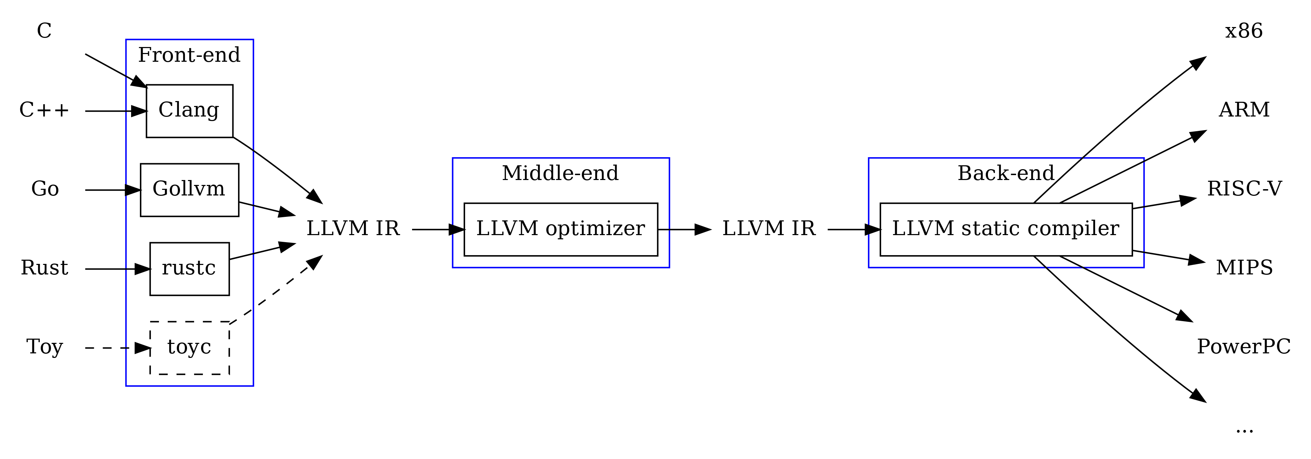
Modular Architecture Overview

Slide 6
Continue…
Frontend
  Converts source code into LLVM Intermediate Representation (IR).Examples: Clang (C/C++), Swift Compiler.
Optimizer
  Performs transformations and optimizations on IR. Focuses on performance, memory, and power efficiency.
Backend
  Translates IR into machine-specific code. Targets multiple hardware architectures.

Slide 7
Advantages of LLVM
Modularity
High Performance
Scalability
Community-Driven

Slide 8
Limitations of LLVM
Complexity
Steep learning curve for beginners.
Some optimizations are resource-intensive.
Can be challenging to adapt to unique hardware.
Overhead
Integration

Slide 9
FUTURE OF COMPILER CONSTRUCTION
Sayeed Tauheed Shah (14143)

Slide 10
Breakthrough Trends in Compiler Technology
AI-Driven Compilation:
Future compilers will integrate cutting-edge machine learning models to enable advanced optimization processes.
Multi-Language Ecosystems:
  Compilers of the future will not only support multiple languages but also facilitate smooth interoperability
Quantum and Hybrid Computing Compilers:
  Specialized compilers for quantum systems will evolve to support hybrid computing

Slide 11
Key Innovations to Expect
Self-Adaptive Compilers:
  Future compilers will feature self-adaptive capabilities, allowing them to optimize code dynamically during runtime.
Domain-Specific Language (DSL) Optimization:
  Specialized compilers tailored for specific domains (e.g., AI, graphics, or bioinformatics)
Enhanced Security Features:
  Next-generation compilers will integrate advanced static and dynamic analysis tools to detect vulnerabilities early in the development process.
Human-Centric Compiler Interfaces:
  Compilers will become more user-friendly

Slide 12
Vision for the Future
Intelligent Compilers as Coding Partners:
The future envisions compilers acting as intelligent assistants, providing real-time insights, optimization suggestions, and code refactoring advice.
Fully Autonomous Compiler Systems:
  Compilers will evolve into self-improving systems, using reinforcement learning to refine their optimization strategies autonomously

Slide 13
Thank You !

